Slide 1
Computer Architecture:
The Compiler, Linker, Loader
Dr. Colin O’Flynn

Slide 2
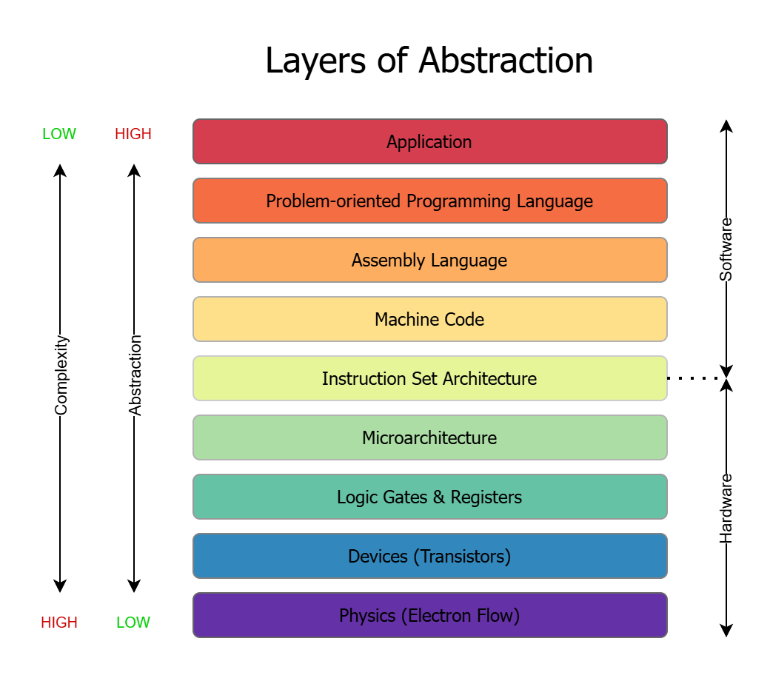

Slide 3
High Level Language → Running Code
Source
(.c / .cpp)
Preprocessor
Preprocessed C Source
(.i / .ii)
Compiler Front-End
Intermediate Representation (IR)
Headers
(.h / .hpp)
Compiler Back-End
Assembly
(.s)
Object File (.o)

Slide 4
High Level Language → Running Code
Object File (.o)
Object File (.o)
Object File (.o)
Linker
Binary
(.ELF)
objtool
Libraries
Final Binary
(.bin or .hex)
Linker Script

Slide 5
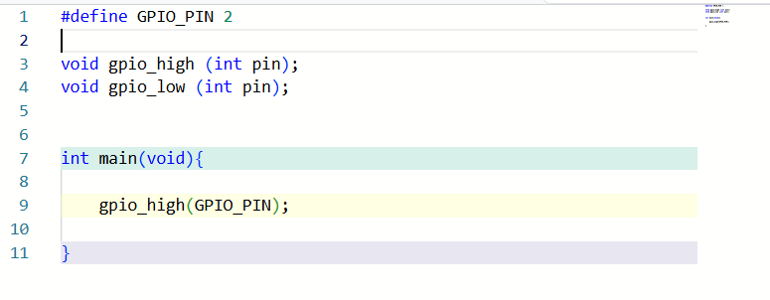
C/C++ Source Code (.c + .h)

Slide 6
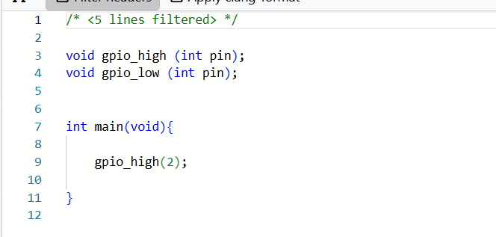
Preprocessed Source Code (.i / .ii)

Slide 7
e.g., Preprocessor Dangers #1
#define SQUARE(x) x * x
…
int result = SQUARE(4 + 1);

Slide 8
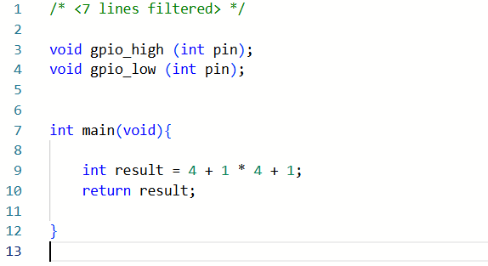

Results of Compiler Explorer
Try it @ https://godbolt.org/

Slide 9
e.g., Preprocessor Dangers #2
#define CtoF(x) (x * 1.8) + 32
//This works fine:
printf(“Temp %dC is %dF\n”, c, CtoF(c));

Slide 10
Try It!
#include <stdio.h>
#define CtoF(x) (x * 1.8) + 32
#define NORMAL_TEMP_C (50)
// User manual says max temp is 1.5x normal
// temp, but they use Fahrenheit so we convert
// to be sure we exactly follow their calc.
int test_temp(int c){
if (CtoF(c) > CtoF(NORMAL_TEMP_C)*1.5) {
printf("WARNING: Temperature Exceeded\n");
}
}

Slide 11
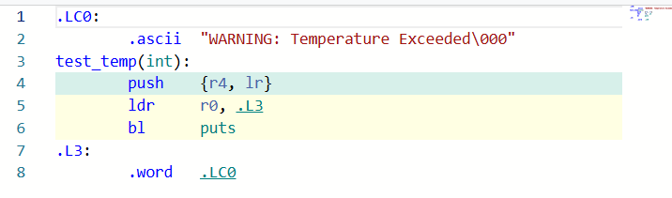

Slide 12
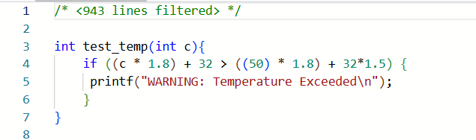

Slide 13
Compiler Front-End (Target Independent)
Parses C/C++ (or other language) syntax
Builds an “Abstract Syntax Tree” (AST)
Performs:
  Type checking
  Scope resolution
  Basic semantic check

Slide 14
Basic Semantic Checks vs. Static Analysis
Compiler provides basic checks on C/C++ correctness
Can turn on various level of warnings to improve your detection
int compute(int flag) {
int result;
if (flag > 0) {
result = flag * 10;
}
return result;
}

Slide 15
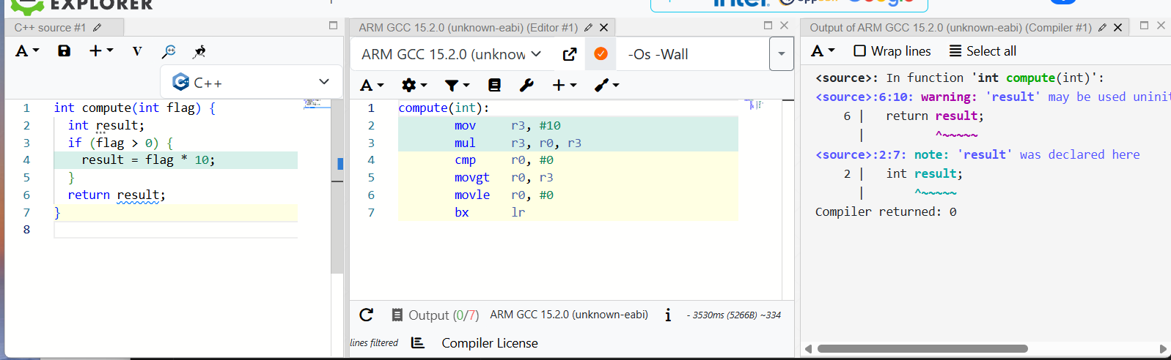
Try It!
Add “-Wall”
Click this button

Slide 16
Code Linting
Static Analysis does more intensive checking than simple compiler front ends.
cppcheck (for both C & C++) is a good tool!
https://github.com/danmar/cppcheck
Easy to install (Ubuntu):
sudo apt install cppcheck
Easy to use:
cppcheck bad.c (one file)
cppcheck folder (bunch of files)

Slide 17
Gimpel PC-Lint Bug Resources
Gimpel had PC-Lint, a great commercial linter.
Now owned by a bigger company, so you need archive.org for their more interesting history:
https://web.archive.org/web/20190415235824/http://www.gimpel.com/html/bugs.htm
https://web.archive.org/web/20170627143350/http://www.gimpel.com/html/bugs/bug525.htm

Slide 18
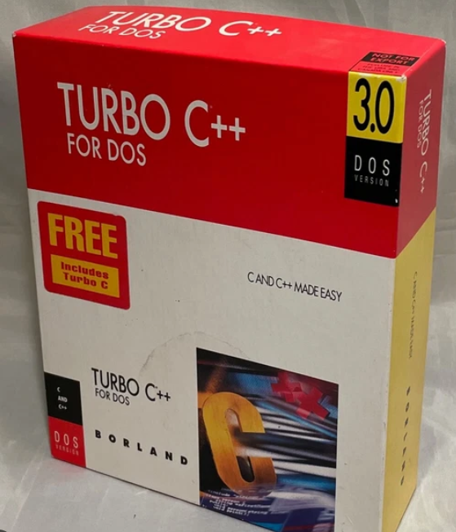
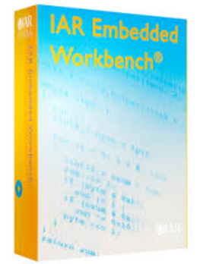
Classic Compiler Architecture
Classic compiler architecture (e.g., early GCC) was tightly coupled to back-end
Optimizations often target-specific

Slide 19
Low Level Virtual Machine (LLVM)
Name is a reference to research on dynamic compilation – now encompasses many things
Uses “Intermediate Representation” (IR)
LLVM IR Optimizer optimizes generic IR code
Originally designed to take IR output from GCC frontend… but…

Slide 20

Clang
Originally developed by Apple for various reasons
  Apple uses Objective-C (low priority for GCC devs)
  GCC codebase is older & naturally larger being developed over many years
  GCC is GPL licensed (potentially an issue commercially)
  Desire to have a more modular tool that can be more easily integrated with other source-code tools
Clang is more easily integrated/parsed
Clang is now the LLVM frontend

Slide 21
New GCC vs. LLVM/Clang
Internally GCC uses it’s own Intermediate Representation
Clang outputs LLVM IR
GCC is a complete compiler to generate binary (object)
Clang is not – requires LLVM to generate binary (object)

Slide 22
GCC vs. LLVM/Clang
People have different opinions about GCC vs. Clang
They have different output styles, warnings, may find more (or less) possible errors, etc.
Historically Clang performance was worse than GCC (but faster to compile). This is no longer a generically true statement.

Slide 23
Intermediate Representation Example
Basically – lower-level than C, higher-level than ASM
Mostly “Static Single Assignment” (SSA)
E.g.:
%1 = load a
%2 = load b
%3 = add %1, %2
store %3 -> c

Slide 24
Optimization
SSA simplifies optimization
Typically at minimum compiler will:
  Remove unnecessary stack & memory load/stores
  Dead code elimination (DCE)
See https://gcc.gnu.org/onlinedocs/gcc/Optimize-Options.html

Slide 25
Optimization Examples
#include <stdio.h>
void gpio_on(void);
void gpio_off(void);
void gpio_toggle();
void toggle_led(void){
//gpio_on();
//gpio_off();
gpio_toggle();
}
int some_function(int data){
if (data > 0) {
for(int i = 0; i < 4; i++){
toggle_led();
}
return 0;
}
if (data < 0) {
for(int i = 0; i < 10; i++){
toggle_led();
}
}
if (data > 0){
toggle_led();
return 2;
}
return 3;
}

Slide 26
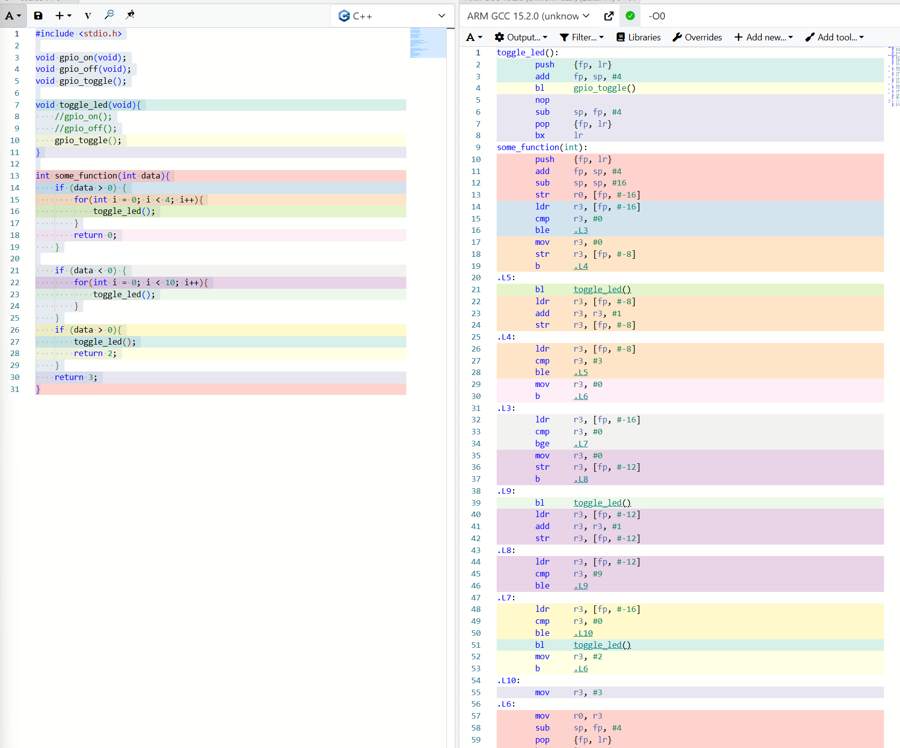

Slide 27
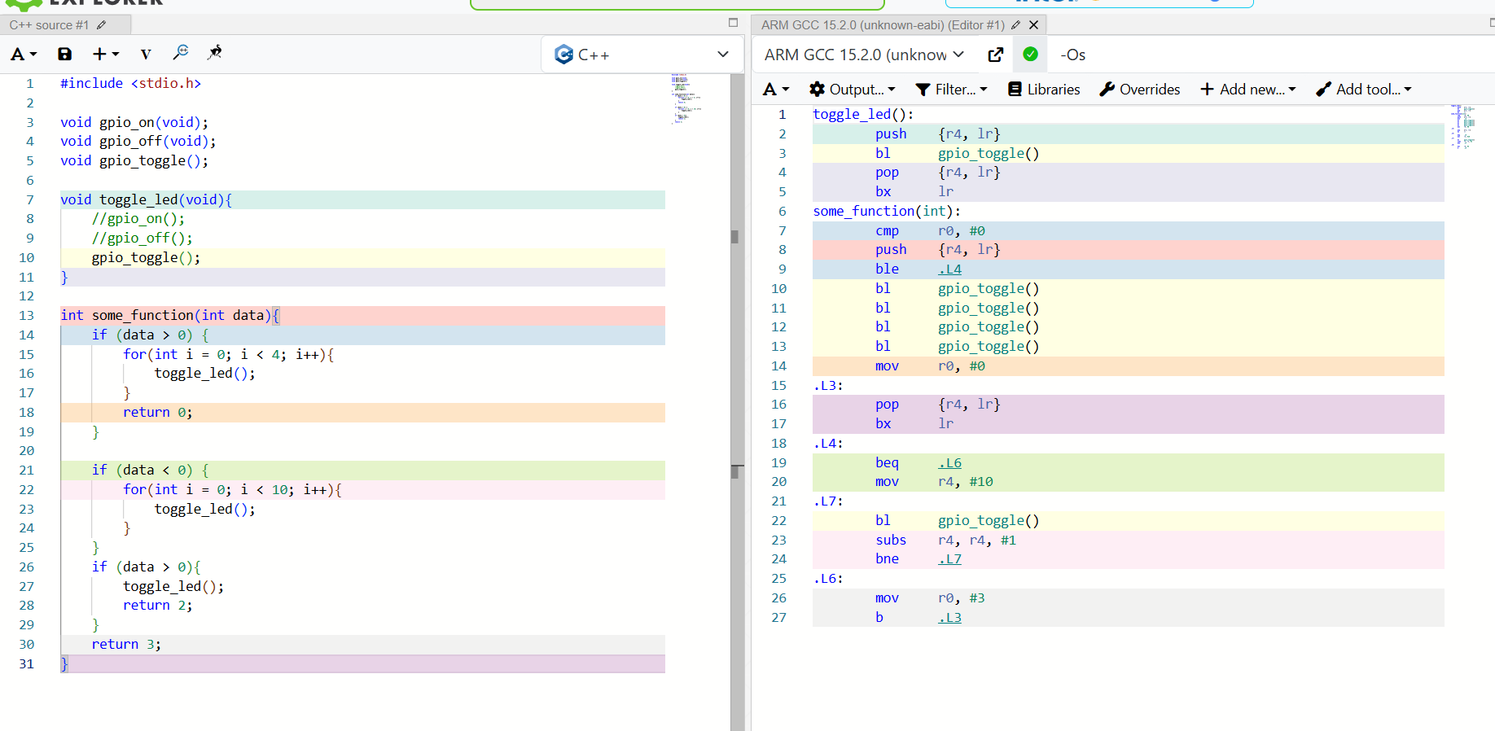

Slide 28
Function inlining
Loop unrolling
Unreachable Code

Slide 29
Assembler Output
After optimization the compiler writes an assembler file which is machine-dependant
We looked at different assembly types in the last lecture
Remember things are still “human readable” at this stage – note the use of labels, function names, etc

Slide 30
Object File
Object file contains:
  Machine code (no longer assembly)
  Symbol table (function names, variables, etc)
  Relocation entries
Addresses & Object Files
  Addresses are not final in the object file yet
    Addresses of certain variables, functions etc are not known yet
  The object file(s) will be finalized by the linker

Slide 31
Libraries
We may use libraries which contain pre-compiled object files
Normally this is for convivence (well optimized routines)
Sometimes these may be commercial and provided in binary form
Normally calling one function from a library may link in the entire library unless special work done to remove unused library code

Slide 32
Embedded Systems & Code Size
If you have limited space, need to be very careful calling certain functions such as printf()

Slide 33
Embedded Standard Libraries
Normal to have “C standard library” linked for things in <stdio.h>, <strings.h>, etc.
When compiling for your desktop with GCC, you would normally have glibc linked in
On embedded systems this has space issues…

Slide 34
Embedded Standard Libraries
newlib is common on embedded
newlib-nano is an even smaller version, common on Cortex-M (the most likely default of any toolchain you use)
newlib-nano often has no printf() support for floating point

Slide 35
The Linker
Combines object files (user + libraries)
Resolves symbols to final addresses
Assigns final addresses
Need to ensure it is linking startup code (sometimes this gets removed by accident when changing linkter options!)

Slide 36
Linker Scripts
The Linker Script defines where in memory things go, e.g.:
FLASH (rx) : ORIGIN = 0x08000000, LENGTH = 512K
RAM (rwx): ORIGIN = 0x20000000, LENGTH = 128K
Let's look in more detail at one, example from https://github.com/newaetech/chipwhisperer/blob/develop/firmware/mcu/hal/stm32f3/LinkerScript.ld

Slide 37
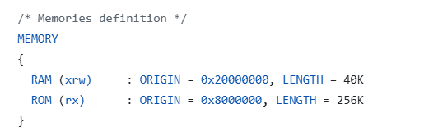

Slide 38
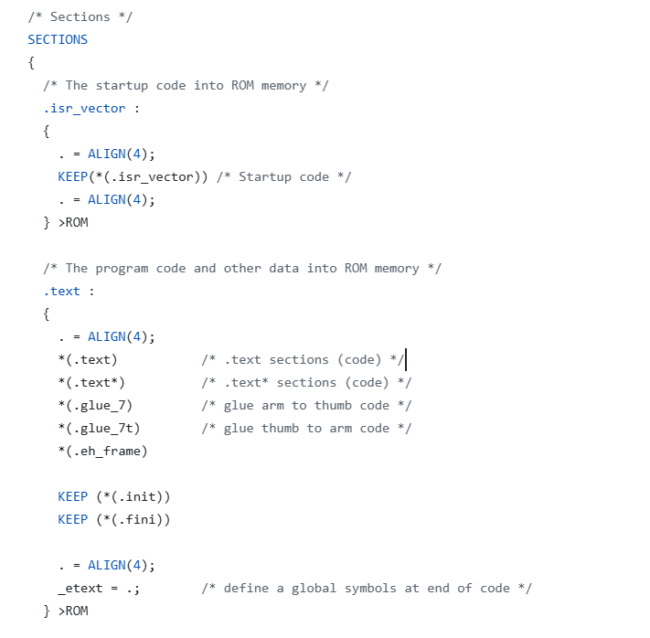

Slide 39
GCC Linker Script Options
You can pass options to the linker in gcc to specify what libraries to include.
Weird errors complaining about “no _write()” may be linker error setup!
Often on embedded we see --specs=nosys.specs as an option passed to the linker.

Slide 40
Memory Segments
.text (code) Segment:
  Compiled machine code instructions and read-only data, such as string literals and global constants
  Typically marked as read-only and executable to prevent accidental modification during program execution

Slide 41
Memory Segments
.data Segment:
  Stores global and static variables that are explicitly initialized by the programmer.
  This is a writable area of memory, as these variables can change during runtime.

Slide 42
Memory Segments
.bss (Block Started by Symbol) Segment:
  Holds uninitialized global and static variables, or those initialized to zero.
  Storing them in the BSS segment makes the file smaller; this section of memory is all written to zero on startup

Slide 43
Memory Segments
Heap Segment:
  Used for dynamic memory allocation requested during program execution using functions like malloc(), calloc()
  May or may not be used

Slide 44
Memory Segments
Stack Segment:
  Used for managing function calls, local (automatic) variables, and return addresses
  Operates as a last-in, first-out (LIFO) structure
  Memory is automatically allocated and reclaimed as functions are called and return.
  Very bad things happen if you run out of this!

Slide 45

Linker Memory Allocation

Slide 46
Hint if Program is Crashing
Lazy programmer trick: increase stack in the Linker Script and see if it works.
If you do something with a lot of stack usage (allocating big variables on stack, using RTOS, etc) – may need to increase stack size!

Slide 47
Startup Code?
Your code is NOT the first thing run, even on "bare metal"
There is normally startup code that does some needed setup.
Following example is from STM32F3 default startup code, example at https://github.com/newaetech/chipwhisperer/blob/develop/firmware/mcu/hal/stm32f3/stm32f3_startup.S

Slide 48
e.g., stm32f3 startup code
.section .text.Reset_Handler
.weak Reset_Handler
.type Reset_Handler, %function
Reset_Handler:
/* Copy the data segment initializers from flash to SRAM */
movs r1, #0
b LoopCopyDataInit
CopyDataInit:
ldr r3, =_sidata
ldr r3, [r3, r1]
str r3, [r0, r1]
adds r1, r1, #4
LoopCopyDataInit:
ldr r0, =_sdata
ldr r3, =_edata
adds r2, r0, r1
cmp r2, r3
bcc CopyDataInit
ldr r2, =_sbss
b LoopFillZerobss
/* Zero fill the bss segment. */
FillZerobss:
movs r3, #0
str r3, [r2]
adds r2, r2, #4
LoopFillZerobss:
ldr r3, = _ebss
cmp r2, r3
bcc FillZerobss
/* Call the clock system intitialization function.*/
bl SystemInit
/* Call static constructors */
bl __libc_init_array
/* Call the application's entry point.*/
bl main
LoopForever:
b LoopForever

Slide 49
ELF Files and Debug Symbols
ELF (Executable and Linkable Format) is a standard file format for executable files & object code.
Supports extensive additional information (including debug information).
Normally this file then gets written to a final binary for the embedded system (.bin or .hex).

Slide 50
Debugging Optimized Code
More difficult! Will see this once we get to debugging…

Slide 51
Loader?
Normally we also have a loader that loads the executable and performs needed setup.
This isn’t normally relevant on small embedded systems – the entire binary is being run directly.
More complex embedded systems (Linux) still have loaders.

Slide 52
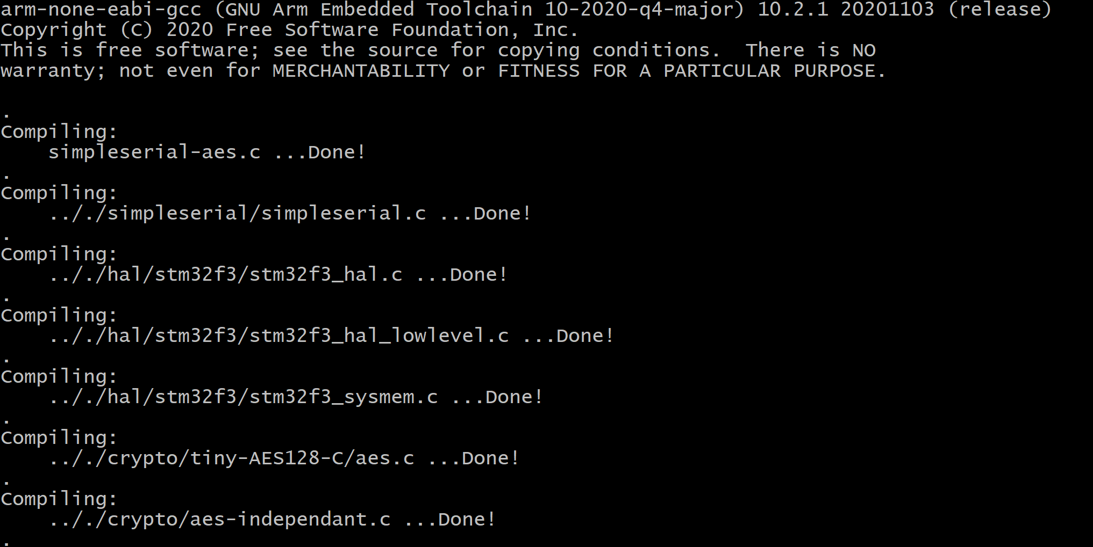
Putting it Together – An Example
Running "Make"… part 1

Slide 53
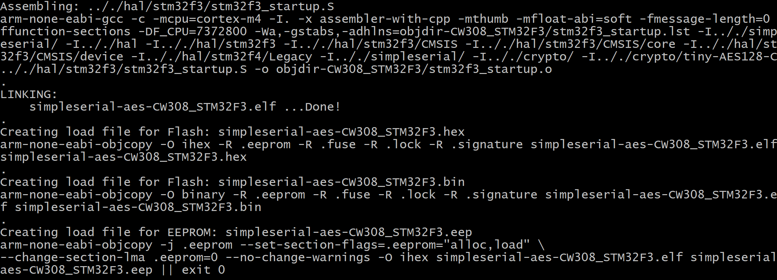
Make output continued

Slide 54
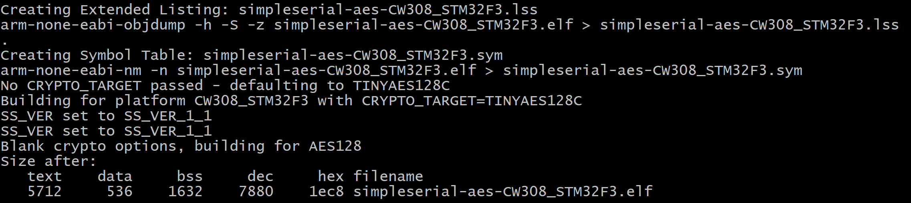
Make output continued

Slide 55
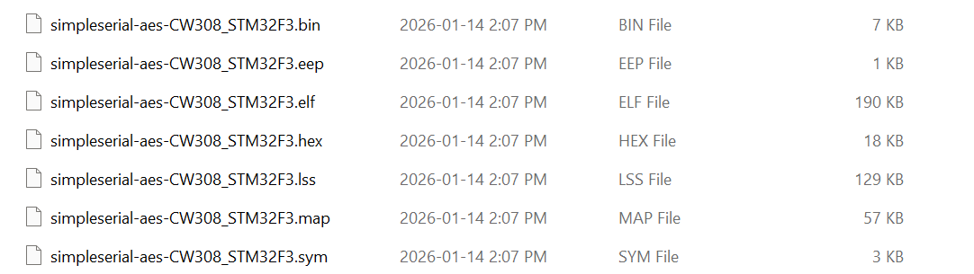
Additional Useful Outputs
.bin, .hex, and .eep are for programming (not useful to you)
.elf = for debugging (useful indirectly)
.lss = Listing Symbols, very useful to look at (may need to enable this)
.map = Memory map including symbols & source files
.sym = Symbols and location in memory

Slide 56
Live Example Pause Slide
This slide is to remind me live demos of:
Building firmware & showing output
Going through each of the prior files (lss, map, sym)
Debugging example, show startup code

Slide 57
Summary
Compiler converts our source code to some intermediate representation (IR)
Optimization on this IR may change the code or program flow – turning off optimizations should not fix your code
Machine-dependant assembly code is written – this is still missing startup code & final address assignments
The linker performs final address assignment, and links in libraries (including startup code).

